Slide 1

Impact of Income and Insurance Status on Substance Use Disorder Treatment in Maternal Health
Research Design Study
Notes:
Be specific and direct in the title. Use the subtitle to give the specific context of the speech.
-The goal should be to capture the audience’s attention which can be done with a quote, a startling statistic, or fact. It is not necessary to include this attention getter on the slide.

Slide 2

Hypothesis Questions
Does lower income correlate with reduced access to substance use disorder (SUD) treatment for maternal health?
Do mothers from higher-income households achieve better outcomes in SUD treatment compared to those from lower-income households?
Does the interaction between low income and lack of insurance exacerbate disparities in access to SUD treatment for maternal health?
Notes:
Use the background points to post details that are not common knowledge, or that the audience will need to understand the context of the speech.
-Do not read these main points from the PowerPoint, instead elaborate on these points during the speech.

Slide 3

Hypothesis Questions continue
Are maternal health outcomes significantly worse for uninsured mothers with SUD compared to insured mothers?
Are pregnant mothers with low income and no insurance more likely to experience delays in initiating SUD treatment?
Notes:
Use the background points to post details that are not common knowledge, or that the audience will need to understand the context of the speech.
-Do not read these main points from the PowerPoint, instead elaborate on these points during the speech.

Slide 4

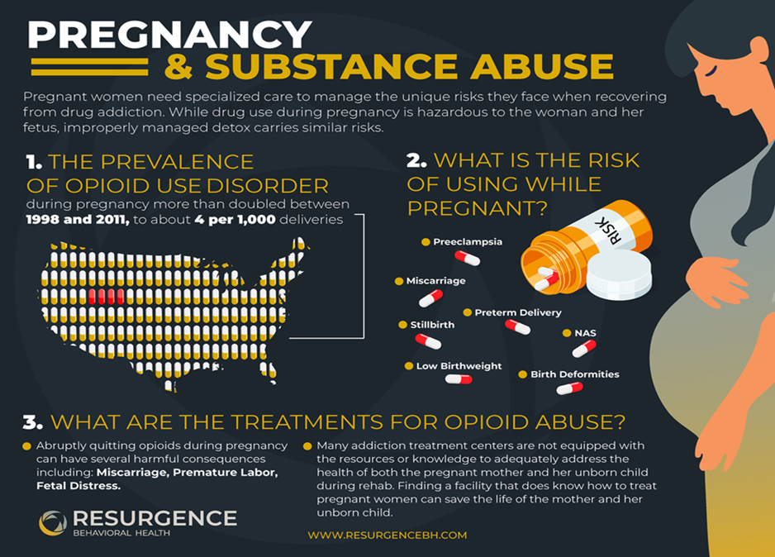
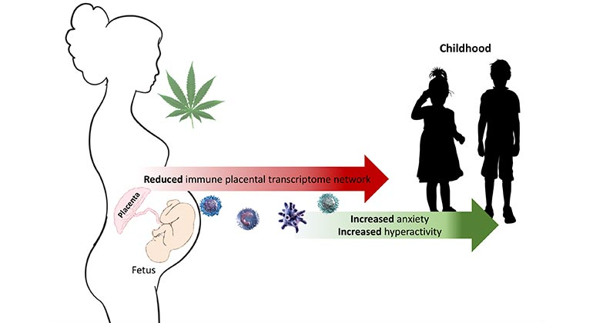
Focus Substance ( Drugs )
OPIODS
Marijuana (Cannabis )
Pregnancy & Substance Abuse Treatment Infographic

Slide 5
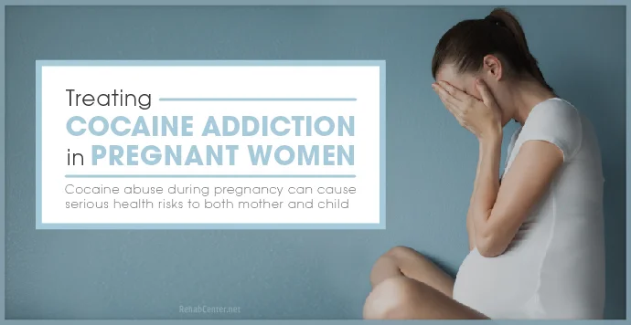
Focus Substance ( Drugs )
Stimulants (Cocaine )

Slide 6
Evidence-Based SUD Treatment
Medication-assisted treatment (MAT) using FDA-approved drugs (e.g., methadone, buprenorphine, naltrexone)
Cognitive-behavioral therapy (CBT)
Motivational interviewing (MI)
Contingency management
Treatment approaches that have been rigorously tested in clinical trials and shown to be effective through research. These methods are supported by scientific evidence and typically align with guidelines from organizations like SAMHSA (Substance Abuse and Mental Health Services Administration) or WHO (World Health Organization)
Notes:
The title of main point #1 should be clear and concise. Each piece of evidence should be summarized for clarity and cited correctly. Do not simply read the pieces of evidence, but elaborate where needed.
[type notes for elaboration here]
Be sure to transition to main point #2 and the next slide.

Slide 7
Comprehensive SUD Treatment
Prenatal and maternal care (for pregnant women
Housing assistance
Parenting support
Legal aid or childcare services
Holistic care that addresses the full range of an individual’s needs beyond substance use, which may include physical health, mental health, social support, and life circumstances
Notes:
The title of main point #2 should be clear and concise. Each piece of evidence should be summarized for clarity and cited correctly. Do not simply read the pieces of evidence, but elaborate where needed.
[type notes for elaboration here]
Be sure to transition to main point #3 and the next slide.

Slide 8

First Data Sourced
Women Health Survey ( Substance Use Disorder )
Primary Collected ( Memphis Area – Church Affiliated )
Non-Diverse ( income high, age group , lack disparities )
Survey Link :

Slide 9
2nd Data Sourced ( NIH ALL of Us Research Survey Data)
Basic ( Insurance and Income status
Lifestyle Survey ( Substance Access Section )
Personal Medical History Survey (Mental health and substance use condition Section)
SDOH survey ( Health Care provider Treatment Section )
Health Care Access and Utilization survey

Slide 10
Basic Survey ( Income & Insurance Coverage)
Are you covered by health insurance or some other kind of health care plan?
Are you currently covered by any of the following types of health insurance or health Coverage plans ?
What is your annual household income from all sources?

Slide 11
Lifestyle Survey ( Substance Access Section )
In your LIFETIME, which of the following substances have you ever used Marijuana , coke, crack ,ecstasy, stimulants or opioids ?
In the PAST THREE MONTHS, how often have you used cocaine (coke, crack, etc.)?
In the PAST THREE MONTHS, how often have you used prescription stimulants for non-medical reasons (Vyvanse, Ritalin, Concerta, Dexedrine, Adderall, diet pills, etc.)?
In the PAST THREE MONTHS, how often have you used other stimulants (methamphetamine, speed, crystal meth, ice, k2/spice, bath salts, etc.)?
In the PAST THREE MONTHS, how often have you used inhalants (nitrous oxide, glue, gas, paint thinner, etc.)?
In the PAST THREE MONTHS, how often have you used sedatives or sleeping pills for non-medical reasons (Valium, Serepax, Ativan, Xanax, Librium, Rohypnol, GHB, etc.)?
In the PAST THREE MONTHS, how often have you used hallucinogens (LSD, acid, mushrooms, PCP, Special K, ecstasy, etc.)?
In the PAST THREE MONTHS, how often have you used street opioids (heroin, opium, etc.)?
In the PAST THREE MONTHS, how often have you used prescription opioids for nonmedical reasons (obana, fentanyl, oxycodone [OxyContin, Percocet], hydrocodone [Vicodin], methadone, buprenorphine [Suboxone], etc.)

Slide 12
Personal Medical History ( Mental Health & Substance Use Conditions Section
Has a doctor or health care provider ever told you that you have…?
Alcohol use disorder
Anxiety reaction/panic disorder
Attention-deficit/hyperactivity disorder (ADHD)
Autism spectrum disorder
Bipolar disorder • Depression
Drug use disorder • Eating disorder
Other mental health or substance use condition
2. Are you still seeing a doctor or health care provider for this condition? Yes/No
3. Are you currently prescribed medications and/or receiving treatment for this condition? Yes/No

Slide 13

SODH ( Healthcare Provider Treatment Section)
The next statements describe how others may treat you. How often do any of these happen to you when you go to a doctor’s office or other health care provider?
You are treated with less courtesy than other people
You are treated with less respect than other people.
You receive poorer service than others.
A doctor or nurse acts if he or she thinks you are not smart.
A doctor or nurse acts as if he or she is afraid of you.
A doctor or nurse acts as if he or she is better than you.
You feel like a doctor or nurse is not listening to what you were saying

Slide 14
HealthCare Access & Utilization Survey
DURING THE PAST 12 MONTHS, were you told by a health care provider or doctor’s office that they did not accept your health care coverage?
DURING THE PAST 12 MONTHS, have you seen or talked to any of the following doctors or health care providers about your own health? …A nurse practitioner, physician assistant, or midwife?
What is the total number of nurse practitioner, physician assistant, or midwife visits you made in the last 12 months?
DURING THE PAST 12 MONTHS, have you seen or talked to any of the following doctors or health care providers about your own health? …A doctor who specializes in women’s health (an obstetrician/gynecologist)?
What is the total number of visits to a doctor who specializes in women's health that you made in the last 12 months?

Slide 15
References
National Institute om Drug Abuse, https://nida.nih.gov/publications/research-reports/substance-use-in-women/substance-use-while-pregnant-breastfeeding
Resurgence Behavioral Health, https://www.prnewswire.com/news-releases/dr-lawrence-tucker-of-resurgence-behavioral-health-provides-specialized-treatment-for-pregnant-women-with-substance-use-disorder-301411589.html
https://www.choicepointhealth.com/pregnancy-and-addiction-guide-to-rehab-for-pregnant-mothers

